Slide 1
Leveraging Query Store for Improved Performance
Notes:
Good morning and I'm glad everyone could join us. This morning we're going to be talking about “Modern SQL Server Features That Make Life Better.”

Slide 2
Thank You!
Thank you, SQL Saturday Boston!!

Slide 3

Thank You!

Slide 4
Feedback welcome
Speakers are always looking for feedback so please use the conference mechanism to let me you what you like and how you think the session could be improved.

Slide 5


About Me
Entered IT in Feb 2008
MCTS SQL Server 2008 Implementation and Maintenance in May 2013
Azure Fundamentals and Azure Data Fundamentals in Feb/March 2021
Database Administrator since 2014
Notes:
Here is a bit about me. I got my start in SQL Server 15 years ago by using SQL Server Reporting Services to build custom reports for my employer.
I was also fascinated by the SQL Server engine underneath and at the time I also got the chance to learn SQL Server transactional replication as part of supporting a key application.
I did a lot of self study and 5 years after starting with SQL Server I earned my first certification. I earned two more in the spring of 2021. I would encourage you to look at my blog at leemarkum.com and you can contact me on Bluesky. You can also find me on LinkedIn, or feel free to email me at the address on the slide.

Slide 6
About Me
Blog at https://leemarkum.com/
Currently a Senior SQL DBA Consultant at The SERO Group (Views expressed here are my own)
Have spoken at a number of SQL Server Meetup events, SQL Saturdays and Saint Louis DevUp
lmarkum@live.com
BlueSky - @leemarkum.bsky.social
LinkedIn – https://linkedin.com/in/leemarkum
Notes:
Here is a bit about me. I got my start in SQL Server 15 years ago by using SQL Server Reporting Services to build custom reports for my employer.
I was also fascinated by the SQL Server engine underneath and at the time I also got the chance to learn SQL Server transactional replication as part of supporting a key application.
I did a lot of self study and 5 years after starting with SQL Server I earned my first certification. I earned two more in the spring of 2021. I would encourage you to look at my blog at leemarkum.com and you can contact me on Bluesky. You can also find me on LinkedIn, or feel free to email me at the address on the slide.

Slide 7
Setting Expectations
The goal is to provide level 100-200 coverage of Query Store. We’ll talk some basics and get into deeper detail on some topics.
This is a large topic and could easily be an all-day session at a conference.
Follow up presentations would be needed to cover and demo specific query store functionality in a level 300 and above fashion.

Slide 8
Agenda
Discuss features in the following categories:
Why Query Store
What does Query Store do
Intelligent Query Processing and Query Store
How to configure Query Store
SQL Server Community tools for examining Query Store data
Notes:
Our agenda is to touch on the following categories of features so that you can see how modern SQL Server features will simplify or improve your experience as a data professional.
We’re going to look at some performance related features in SQL Server followed by new aspects of the product that I think are helpful for troubleshooting.
Next, we’ll look at some useful changes concerning permissions and then we’ll cover some helpful T-SQL changes.
Last, we will consider to features in the category of High Availability and Disaster Recovery.

Slide 9
Why Query Store?
Capturing, storing and aggregating performance metrics was hard
SQL trace, extended events, or querying the cache are expensive to do to get all the same data Query Store provides and in pre-aggregated way.
Management Data Warehouse was an attempt to bring query performance data inside SQL Server. Last documentation update was Dec 2023.
Also, you can’t do things like easy plan forcing, the performance feedback features in later versions of Query Store, and other things I’ll describe later on.
Notes:
Query Store solves the challenge of persisting performance data over time. Prior to Query Store, there was the Management Data Warehouse in SQL Server, and that feature can still be enabled, but Query Store is superior to Management Data Warehouse. Collecting and aggregating data from SQL Trace also didn’t capture everything needed, long term, without doing unadvisable things, like capturing query plans.
Query Store is easier to turn on and has very little management needed, unlike what I experienced when testing the Management Data Warehouse feature. Outside of that, you had to have a server-side trace collecting data, or later, extended events sessions capturing performance.
Both of these methods, but particularly server-side trace, has some significant overhead depending on what you’re trying to capture – like query plans, for example. You could also do things like record the output of Adam Machanic’s sp_whoisactive to a database.
I don’t think any of these approaches gives you the kind of insight that Query Store provides and all of these previously mentioned options are things that you would have to manage on a regular basis, or put a fair amount of effort into just to set up and capture what you’re interested in.
So, Query Store makes life better simply by freeing you from having to create and manage your own monitoring process or convince your boss to buy pricey monitoring software from a 3rd party. And some employers only want to use native monitoring methods and say so in their job postings.

Slide 10
What does Query Store do?
Stores aggregated query runtime performance based on AVG, MAX, MIN, etc.
CPU Time (ms)
Duration(ms)
Logical reads(kb)
Physical Reads(kb)
DOP
Memory Consumption(kb)
Captures query plans
Wait Stats information is available in SQL 2017 and above
Custom Capture Policies in 2019 to allow better control over what is captured so Query Store performs better.
Notes:
Query Store solves the challenge of persisting performance data over time. Prior to Query Store, there was the Management Data Warehouse in SQL Server, and that feature can still be enabled, but Query Store is superior to Management Data Warehouse.
Query Store is easier to turn on and has very little management needed, unlike what I experienced when testing the Management Data Warehouse feature. Outside of that, you had to have a server-side trace collecting data, or later, extended events sessions capturing performance.
Both of these methods, but particularly server-side trace, has some significant overhead depending on what you’re trying to capture – like query plans, for example. You could also do things like record the output of Adam Machanic’s sp_whoisactive to a database.
I don’t think any of these approaches gives you the kind of insight that Query Store provides and all of these previously mentioned options are things that you would have to manage on a regular basis, or put a fair amount of effort into just to set up and capture what you’re interested in.
So, Query Store makes life better simply by freeing you from having to create and manage your own monitoring process or convince your boss to buy pricey monitoring software from a 3rd party. And some employers only want to use native monitoring methods and say so in their job postings.

Slide 11
What does Query Store do?
Reports that show performance graphically
Regressed Queries
Overall Resource Consumption
Top Resource Consuming Queries*
Queries with Forced Plans
Queries with High Variation
Query Wait Statistics*
Tracked Queries*
Notes:
Some additional characteristics of Query Store is that it is enabled per database. You can use it to view not only performance metrics for queries, but query plans as well.
In SQL Server 2022, the Query store plays a central role in most of the newer intelligent query processing features. More stable memory grant feedback, DOP_Feedback, CE Feedback and more all rely on Query Store.
Let’s look at some information collected in the WideWorldImporters database when we did the demo on LightWeight Query Profiling.

Slide 12
What does Query Store do?
Can apply query hints without changing the code. (2022)
Compare two plans to each other side by side
Track a stored procedure’s performance over time by queryid – assuming no one drops and recreates the procedure.
Allows you to detect regression and force “good query plans”
Notes:
Some additional characteristics of Query Store is that it is enabled per database. You can use it to view not only performance metrics for queries, but query plans as well.
In SQL Server 2022, the Query store plays a central role in most of the newer intelligent query processing features. More stable memory grant feedback, DOP_Feedback, CE Feedback and more all rely on Query Store.
Let’s look at some information collected in the WideWorldImporters database when we did the demo on LightWeight Query Profiling.

Slide 13
What does Query Store do?
Caveats to plan forcing with Query Store https://bit.ly/3XXB2oS
There are some limitations that can prevent a plan to be enforced.
First, if the plan contains following constructions:
Insert bulk statement
Reference to an external table
Distributed query or full-text operations
Use of elastic queries
Dynamic or keyset cursors
Invalid star join specification
Notes:
Some additional characteristics of Query Store is that it is enabled per database. You can use it to view not only performance metrics for queries, but query plans as well.
Let’s look at some information collected in the WideWorldImporters database when we did the demo on LightWeight Query Profiling.

Slide 14
What does Query Store do?
Caveats to plan forcing with Query Store https://bit.ly/3XXB2oS
There are some limitations that can prevent a plan to be enforced.
Second, when objects that plan relies on, are no longer available:
Database (if database, where plan originated, doesn't exist anymore)
Index (no longer there or disabled)
Finally, problems with the plan itself:
Not legal for query
Query Optimizer exceeded number of allowed operations
Incorrectly formed plan XML
The point is, plan forcing isn't full-proof!
Notes:
Some additional characteristics of Query Store is that it is enabled per database. You can use it to view not only performance metrics for queries, but query plans as well.
Let’s look at some information collected in the WideWorldImporters database when we did the demo on LightWeight Query Profiling.

Slide 15
What does Query Store do?
Permissions for using Query Store:
To view/execute Query Store reports, the minimum permission needed is:
VIEW DATABASE STATE in each database where it is enabled.
The VIEW SERVER STATE permission is at the server level and includes VIEW DATABASE STATE for all databases.
Keep the issue of permissions in mind for Developers who may want access to view Query Store information.
Notes:
Some additional characteristics of Query Store is that it is enabled per database. You can use it to view not only performance metrics for queries, but query plans as well.
Let’s look at some information collected in the WideWorldImporters database when we did the demo on LightWeight Query Profiling.

Slide 16
What does Query Store do?
DEMO comparing CPU BEFORE/AFTER a certain time.
Notes:
Some additional characteristics of Query Store is that it is enabled per database. You can use it to view not only performance metrics for queries, but query plans as well.
Let’s look at some information collected in the WideWorldImporters database when we did the demo on LightWeight Query Profiling.

Slide 17
Leveraging Query Store for Improved Performance
Query Store:
How does it relate to Intelligent Query Processing?
Notes:
Some additional characteristics of Query Store is that it is enabled per database. You can use it to view not only performance metrics for queries, but query plans as well.
In SQL Server 2022, the Query store plays a central role in most of the newer intelligent query processing features. More stable memory grant feedback, DOP_Feedback, CE Feedback and more all rely on Query Store.
Let’s look at some information collected in the WideWorldImporters database when we did the demo on LightWeight Query Profiling.

Slide 18
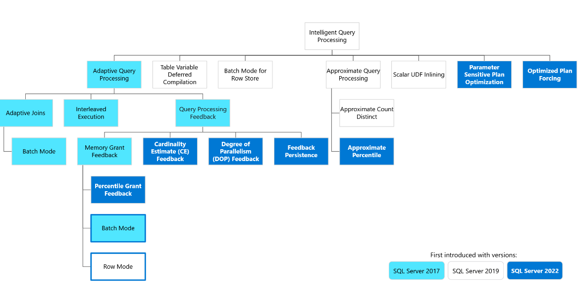
Intelligent Query Processing and Query Store
Intelligent Query Processing Picture from MS Learn https://bit.ly/3C0Zn1B
Notes:
Intelligent Query Processing is a collection of new database engine features, some of which began appearing in SQL Server 2014 and 2016. Some of these features, like memory grant feedback, were enhanced in later versions SQL Server, while more features appeared in each new SQL Server version. I can only talk about a few of these. This topic alone could be an entire day’s pre-conference session.
Memory Grant Feedback is meant to help with scenarios when too much or too little memory is requested for a query. When a query needs to run, a request for memory is made so that the query can run.
A memory grant that is too small can occur when SQL Server underestimates the number of rows involved in an operation and then a spill to disk over on Tempdb occurs. This means that the data that couldn’t be handled in memory was processed on disk in TempDB. When this happens, in these newer versions of SQL Server, the engine now adjusts to provide the query more memory the next time it runs, thus avoiding the spill to Tempdb and making performance better.
In SQL Server 2022, at compat level 160 and with Query Store enabled, memory grant feedback is persisted in the Query Store. No longer is memory grant feedback information lost when SQL Server restarts or the machine is rebooted.

Slide 19
Intelligent Query Processing and Query Store
IQP Feature | Requires Query Store (Read-Write) | Requires Enterprise Edition
Adaptive Joins (Batch Mode) | No | No
Approximate Count Distinct | No | No
Approximate Percentile | No | No
Batch Mode on Rowstore | No | No
Cardinality Estimation (CE) Feedback | Yes | Yes
Degree of Parallelism (DOP) Feedback | Yes | Yes
Interleaved Execution | No | No
Memory Grant Feedback (Batch Mode) | No | No
Memory Grant Feedback (Row Mode) | No | No
Memory Grant Feedback (Percentile & Persistence) | Yes | Yes
Optimized Plan Forcing with Query Store | Yes | Yes
Scalar UDF Inlining | No | No
Parameter Sensitive Plan Optimization | No (Recommended) | No
Table Variable Deferred Compilation | No | No

Slide 20
Intelligent Query Processing and Query Store
Memory Grant Feedback – Batch mode (SQL Server 2017)
Memory Grant Feedback - Row Mode (SQL Server 2019)
Memory Grant Feedback – Percentile and Persisted (SQL Server 2022)
DOP_Feedback (SQL Server 2022)
CE Feedback (SQL Server 2022)
Query Store Hints (SQL Server 2022 all on-prem editions, Azure SQL DB, MI, SQL Database in MS Fabric(in preview) )
https://github.com/microsoft/bobsql

Slide 21
Intelligent Query Processing and Query Store
Memory grant feedback (SQL Server 2017)
Can reduce spills to disk by increasing memory grants
Can reduce wasted memory by lowering memory grants that are too high
- Can result in a “zig-zag” effect where memory grants are constantly shifting up and down based on parameters passed to the affected query. Documentation says the feature will disable if this zig-zag effect happens with a query
Notes:
Memory Grant Feedback is meant to help with scenarios when too much or too little memory is requested for a query. When a query needs to run, a request for memory is made so that the query can run. This is called a memory grant. Once received, then a query can continue being processed by the engine.
For an excessive memory grant condition, if the granted memory is more than two times the size of the actual used memory, memory grant feedback will recalculate the memory grant and update the cached plan.
A memory grant that is too small can occur when SQL Server underestimates the number of rows involved in an operation. When this happens then a spill to disk over on Tempdb occurs. This means that the data that couldn’t be handled in memory was processed on disk in TempDB. When a disk spill occurs in these newer versions of SQL Server, the engine now adjusts to provide the query more memory the next time it runs, thus avoiding the spill to Tempdb and making performance better next time.
batch mode memory grant feedback recalculates the actual memory required for a query and then updates the grant value for the cached plan. When an identical query statement is executed, the query uses the revised memory grant size

Slide 22
Intelligent Query Processing and Query Store
Memory grant feedback (SQL Server 2017)
Feedback is lost on SQL Server restart or use of RECOMPILE
- Needs database compatibility level 140 for batch mode and 150 for row mode
Notes:
Memory Grant Feedback is meant to help with scenarios when too much or too little memory is requested for a query. When a query needs to run, a request for memory is made so that the query can run. This is called a memory grant. Once received, then a query can continue being processed by the engine.
For an excessive memory grant condition, if the granted memory is more than two times the size of the actual used memory, memory grant feedback will recalculate the memory grant and update the cached plan.
A memory grant that is too small can occur when SQL Server underestimates the number of rows involved in an operation. When this happens then a spill to disk over on Tempdb occurs. This means that the data that couldn’t be handled in memory was processed on disk in TempDB. When a disk spill occurs in these newer versions of SQL Server, the engine now adjusts to provide the query more memory the next time it runs, thus avoiding the spill to Tempdb and making performance better next time.
batch mode memory grant feedback recalculates the actual memory required for a query and then updates the grant value for the cached plan. When an identical query statement is executed, the query uses the revised memory grant size

Slide 23
Intelligent Query Processing and Query Store
Persisted and Percentile memory grant feedback (SQL Server 2022)
- Needs compat level 140 and higher.
Needs Query Store enabled and in read-write mode.
Feedback will be persisted in the sys.query_store_plan_feedback catalog view
Notes:
In SQL Server 2022, at compat level 160 and with Query Store enabled, memory grant feedback is persisted in the Query Store. No longer is memory grant feedback information lost when SQL Server restarts or the machine is rebooted.
Additionally, rather than queries experiencing the potential for excessive and then too little memory grant, like in SQL Server 2017, a percentile calculation is used over the course of several executions of the same query. This prevents large swings in memory grants for the same query that uses different parameter values.
“This feature was introduced in SQL Server 2022 (16.x), however this performance enhancement is available for queries that operate in the database compatibility level 140 (introduced in SQL Server 2017) or higher, or the QUERY_OPTIMIZER_COMPATIBILITY_LEVEL_n hint of 140 and higher, and when Query Store is enabled for the database and is in a "read write" state.”

Slide 24
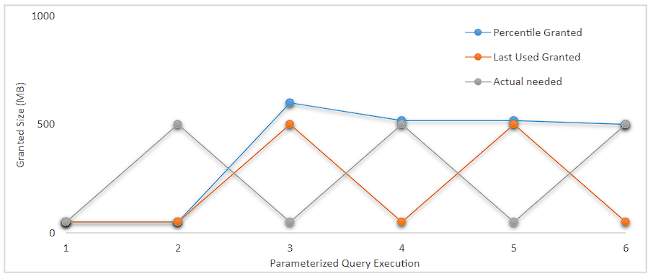
Intelligent Query Processing and Query Store
Persisted And Percentile Memory Grant Feedback (SQL Server 2022)
Notes:
In SQL Server 2022, at compat level 160 and with Query Store enabled, memory grant feedback is persisted in the Query Store. No longer is memory grant feedback information lost when SQL Server restarts or the machine is rebooted.
Additionally, rather than queries experiencing the potential for excessive and then too little memory grant, like in SQL Server 2017, a percentile calculation is used over the course of several executions of the same query. This prevents large swings in memory grants for the same query that uses different parameter values.
“This feature was introduced in SQL Server 2022 (16.x), however this performance enhancement is available for queries that operate in the database compatibility level 140 (introduced in SQL Server 2017) or higher, or the QUERY_OPTIMIZER_COMPATIBILITY_LEVEL_n hint of 140 and higher, and when Query Store is enabled for the database and is in a "read write" state.”

Slide 25
Intelligent Query Processing and Query Store
DOP_Feedback (SQL Server 2022)
Needs compat level 160
Needs Query Store enabled and in read/write mode
Only verified feedback is persisted
- Feedback will be persisted in the sys.query_store_plan_feedback catalog view when we reach a stable degree of parallelism feedback value.
Notes:
DOP feedback self-adjusts DOP to avoid excess parallelism. If parallelism usage is deemed inefficient, DOP feedback lowers the DOP for the next execution of the query, from whatever is the configured DOP, and verify if it helps.

Slide 26
Leveraging Query Store for Improved Performance
How is Query Store Configured?
Notes:
Some additional characteristics of Query Store is that it is enabled per database. You can use it to view not only performance metrics for queries, but query plans as well.
In SQL Server 2022, the Query store plays a central role in most of the newer intelligent query processing features. More stable memory grant feedback, DOP_Feedback, CE Feedback and more all rely on Query Store.
Let’s look at some information collected in the WideWorldImporters database when we did the demo on LightWeight Query Profiling.

Slide 27
How is Query Store Configured?
T-SQL: ALTER DATABASE MyDB SET QUERY_STORE = ON;
PowerShell via DBATools:
Set-DbaDbQueryStoreOption -SqlInstance ServerA -State ReadWrite
-FlushInterval 900 -CollectionInterval 60 -MaxSize 4096
-CaptureMode Auto -CleanupMode Auto -StaleQueryThreshold 30
-AllDatabases (or use –database and provide a list of DB names)
It’s that simple to enable, but there are 8 settings that need to be understood.
Notes:
Some additional characteristics of Query Store is that it is enabled per database. You can use it to view not only performance metrics for queries, but query plans as well.
In SQL Server 2022, the Query store plays a central role in most of the newer intelligent query processing features. More stable memory grant feedback, DOP_Feedback, CE Feedback and more all rely on Query Store.
Let’s look at some information collected in the WideWorldImporters database when we did the demo on LightWeight Query Profiling.

Slide 28
How is Query Store Configured?
Operation_Mode: Off, Read_Write, Read_only. Default is off in the on-prem version for 2016-2019. On is the default in 2022.
Cleanup_Policy/Stale_Query_Threshold_Days: Number of days to hold data for. Default is 30 days in the on-prem version
Notes:
Some additional characteristics of Query Store is that it is enabled per database. You can use it to view not only performance metrics for queries, but query plans as well.
In SQL Server 2022, the Query store plays a central role in most of the newer intelligent query processing features. More stable memory grant feedback, DOP_Feedback, CE Feedback and more all rely on Query Store.
Let’s look at some information collected in the WideWorldImporters database when we did the demo on LightWeight Query Profiling.

Slide 29
How is Query Store Configured?
Data_Flush_Interval_Seconds: How often will in-memory data be flushed to disk. Default is 900 seconds(15 minutes)
Max_Storage_Size_MB: The largest amount of data to be held on disk. Defaults are all too small for most scenarios(100 MB in 2016/2017, 1000 in 2019) Recommendation is 2048 – 4096 MB
Notes:
Some additional characteristics of Query Store is that it is enabled per database. You can use it to view not only performance metrics for queries, but query plans as well.
In SQL Server 2022, the Query store plays a central role in most of the newer intelligent query processing features. More stable memory grant feedback, DOP_Feedback, CE Feedback and more all rely on Query Store.
Let’s look at some information collected in the WideWorldImporters database when we did the demo on LightWeight Query Profiling.

Slide 30
How is Query Store Configured?
Interval_Length_Minutes: Controls the span of aggregated data. Default is 60. The smaller the interval, the more disk space used, but the more granular the data will be.
Size_Based_Cleanup_Mode: Attempt to cleanup as max size is approached. Default is Auto, which means this is enabled by default. Recommendation is to leave this enabled.
Notes:
Some additional characteristics of Query Store is that it is enabled per database. You can use it to view not only performance metrics for queries, but query plans as well.
In SQL Server 2022, the Query store plays a central role in most of the newer intelligent query processing features. More stable memory grant feedback, DOP_Feedback, CE Feedback and more all rely on Query Store.
Let’s look at some information collected in the WideWorldImporters database when we did the demo on LightWeight Query Profiling.

Slide 31
How is Query Store Configured?
Max_Plans_Per_Query: How many distinct plans to keep per query. Default is 200. Option doesn’t exist in 2016.
Wait_Statistics_Capture_Mode: Captures wait stats at database and query level. Default is on. Not available in 2016.
Notes:
Some additional characteristics of Query Store is that it is enabled per database. You can use it to view not only performance metrics for queries, but query plans as well.
In SQL Server 2022, the Query store plays a central role in most of the newer intelligent query processing features. More stable memory grant feedback, DOP_Feedback, CE Feedback and more all rely on Query Store.
Let’s look at some information collected in the WideWorldImporters database when we did the demo on LightWeight Query Profiling.

Slide 32
How is Query Store Configured?
Query_Store_Capture_Mode: Determines the behavior Query Store uses to capture queries.
Default is All for 2016/17. Don’t use this default.
Auto for 2019.
Also has Custom mode available in 2019.
Notes:
Some additional characteristics of Query Store is that it is enabled per database. You can use it to view not only performance metrics for queries, but query plans as well.
In SQL Server 2022, the Query store plays a central role in most of the newer intelligent query processing features. More stable memory grant feedback, DOP_Feedback, CE Feedback and more all rely on Query Store.
Let’s look at some information collected in the WideWorldImporters database when we did the demo on LightWeight Query Profiling.

Slide 33
How is Query Store Configured?
Query_Store_Capture_Mode: Custom mode details -
Help control how data will be stored and which data, allowing granular capture control for ad-hoc workloads.
Stale_Capture_Policy_Threshold (SCPT): Defines the time span during which a query must exceed one of the values in the next three options in order for it to be captured. Valid values are 1 hour up to 7 days.
Notes:
Some additional characteristics of Query Store is that it is enabled per database. You can use it to view not only performance metrics for queries, but query plans as well.
In SQL Server 2022, the Query store plays a central role in most of the newer intelligent query processing features. More stable memory grant feedback, DOP_Feedback, CE Feedback and more all rely on Query Store.
Let’s look at some information collected in the WideWorldImporters database when we did the demo on LightWeight Query Profiling.

Slide 34
How is Query Store Configured?
before query capture occurss
Query_Store_Capture_Mode: Custom mode details -
Execution_Count: How many times a query must be executed within the Stale Capture Policy Threshold.
Total_Compile_CPU_Time_ms: Total cpu compile time a query must use within the Stale Capture Policy Threshold.
Total_Execution_CPU_Time_ms: The total cpu execution time the query must use within the Stale Capture Policy Threshold.
Notes:
Control what will be captured in custom mode and work in OR manner.

Slide 35
How is Query Store Configured?
Trace Flags
7745 - prevents Query store data from writing to disk prior to shutdown or failover process so it doesn’t delay a shutdown or failover.
7752 - Loads Query Store data to memory asynchronously from query execution, preventing Query Store from stopping query execution until its metadata loads.
Notes:
7745 - prevents Query store data from writing to disk prior to shutdown or failover process
7752 - Loads Query Store data to memory asynchronously from query execution. Prior to this TF, if Query Store took a “long time” to load (minutes), then queries it would normally capture could not execute until the Query Store metadata was loaded. 7752 is the default behavior in 2019 and later.
7752 - Loads Query Store data to memory asynchronously from query execution. Prior to this TF, if Query Store took a “long time” to load (minutes), then queries it would normally capture could not execute until the Query Store metadata was loaded. 7752 is the default behavior in 2019 and later.

Slide 36
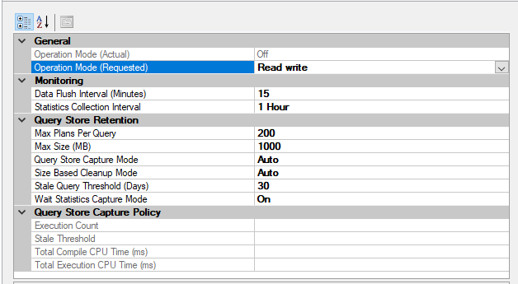
How is Query Store Configured?
before query capture occurss
Defaults from 2019.
Notes:
Some additional characteristics of Query Store is that it is enabled per database. You can use it to view not only performance metrics for queries, but query plans as well.
In SQL Server 2022, the Query store plays a central role in most of the newer intelligent query processing features. More stable memory grant feedback, DOP_Feedback, CE Feedback and more all rely on Query Store.
Let’s look at some information collected in the WideWorldImporters database when we did the demo on LightWeight Query Profiling.

Slide 37
Community Scripts for Query Store
What community scripts exist for querying the Query Store system tables?
Sp_BlitzQueryStore from the First Responder Kit on GitHub (deprecated – On Slack, Brent said to point people to sp_QuickieStore)
https://bit.ly/42aqzc7 (sp_QuickieStore from Erik Darling Data on GitHub)
https://bit.ly/4i6ngY5 (Erin Stellato’s Query Store GitHub)
https://bit.ly/4ifL0t1 (David Schanzer Query Store Toolbox)
https://bit.ly/3Ei13bP (MS Docs Tune Performance with query Store)

Slide 38
Learning More About Query Store
https://bit.ly/2JGUC5J (Blog:Lee Markum - Overview of Query Store)
http://bit.ly/3G2PhTj (Blog:Query Store category on SQLSkills.com)
https://bit.ly/4cUUgjO (Video: Erin Stellato - Why you Need Query Store)
https://bit.ly/3W61tqw (Video: Erin Stellato - Query Store Best Practices)
https://bit.ly/4i6ngY5 (Erin Stellato’s Query Store Github)

Slide 39
Learning More About Query Store
https://bit.ly/3Ei13bP (MS Docs Tune Performance with query Store)
“Query Store for SQL Server 2019” Tracy Boggiano & Grant Fritchey
“SQL Server 2022 Revealed” Bob Ward
“SQL Server 2022 Query Performance Tuning” Grant Fritchey

Slide 40
Leveraging Query Store for Improved Performance
Summary
Why Query Store?
What does it do?
How does Query Store work with intelligent Query Processing?
How is it configured?
What community scripts currently exist for Query Store?

Slide 41
Leveraging Query Store for Improved Performance
Thank you for attending!

Slide 42

Leveraging Query Store for Improved Performance
QUESTIONS?

Slide 43
Contacting Me
lmarkum@live.com
BlueSky - @leemarkum.bsky.social
LinkedIn – https://linkedin.com/in/leemarkum
Notes:
Here is a bit about me. I got my start in SQL Server 15 years ago by using SQL Server Reporting Services to build custom reports for my employer.
I was also fascinated by the SQL Server engine underneath and at the time I also got the chance to learn SQL Server transactional replication as part of supporting a key application.
I did a lot of self study and 5 years after starting with SQL Server I earned my first certification. I earned two more in the spring of 2021. I would encourage you to look at my blog at leemarkum.com and you can contact me on Bluesky. You can also find me on LinkedIn, or feel free to email me at the address on the slide.

